Slide 1
Presentation Title
Your Name
ECO 202
Instructor Name
Notes:
Choose a title for your presentation.
Include your name, the course name and the assignment name.

Slide 2
Monetary Policy
Federal Reserve employs monetary policy to achieve four goals
  Price Stability
  High Employment
  Economic Growth
  Financial Market Stability
Policy tools during the 2007-2008 recession
Interest Rate Policy
The Federal Reserve lowered the federal fund rate to almost zero percent.
Balance sheet policies
The Fed expanded its balance sheet through credit provision in order to facilitate merging of distressed firms and banks to the healthier banks.
The Fed made significant Treasury bond purchases in order to reduce the risk of deflation that would devastate the economy more.
Notes:
Before the Recession in 2008-09, the Federal Reserve had not experienced the zero bound rates. The 2008-09 global recessions led to increase in unemployment, low GDP and deflationary scare. The Fed implemented policies aimed at stimulating the economic activity as well as prevent deflationary pressures. The Fed’s balance sheet policies were expanded to lower cost and enhance credit availability to businesses and households.

Slide 3
Monetary Policy Actions
Expansionary policy
The Fed employed Expansionary policies by lowering the interest rates to nearly zero rates. The Expansionary monetary policies were successful in meeting the expectations for the recovery of the economy. These policies were expected to control inflation and facilitate GDP growth.
Types of Expansionary policies applied
Credit policy and quasi-debt-management- these were designed to lower the cost of borrowing. One primary policy that led to expansion in the balance sheet was large scale purchases by the Federal Reserve.
Bank Reserves Policy
The Fed purchased financial assets with the aim of increasing the money supply and credit hence raising the growth rate of nominal spending to a level that met inflation target.
Notes:
During recession, Expansionary monetary policy facilitates economic growth. This policy allows money to be added to the economic system hence lowering interest rates which ease credit restrictions that are applied by banks during loan applications. Expansionary monetary policy will increase money supply in the economy. this results in increased nominal output. Additionally, increased money supply will encourage consumer spending.

Slide 4
Monetary Policy Actions
Aggregate demand refers to the total demand for the final goods and services produced in the economy at a given price level. It includes a combination of investments, government spending and consumer spending in an economy.
Changes in money supply will have an impact on the GDP, consumer spending and interest rates.
Decrease/increase in money supply results in a decrease/increase in nominal output (GDP)
Increase/ Decrease in money supply will lead to an Increase/decrease in consumer spending.
Increase in money supply results in interest rate reduction hence increasing the aggregate demand.
Increase in money supply will cause a movement up along in the aggregate demand curve. As a result, the prices will be higher and increased GDP.
In addition, the increase in money supply would lead to movement up along the aggregate supply curve. This would lead to a higher prices and more potential real output.
Since Expansionary monetary policy increases the money supply in the economy, private consumption is increased while interest rates are decreased hence enhancing lending and investment.
Notes:
Expansionary monetary policy is implemented by the Federal Reserve with the aim of increasing the economic growth, decrease unemployment levels and increasing the inflation rates from deflation status. Increasing money supply in the economy through expansionary policies will encourage spending, lending and investment and increased output. Inflation also increases while unemployment rates decline.

Slide 5
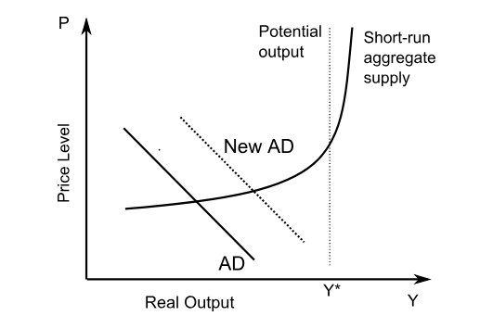
Expansionary Monetary Policy on Aggregate Demand
The graph represents the expansionary monetary policy effects on the Aggregate Demand.
Notes:
Expansionary monetary policy increases the money supply in the economy. as a result, there will be increase in GDP. Increase in money supply will also increase the consumer spending and as a result, the aggregate demand curve shifts to the right.

Slide 6
Monetary Policy Impact
The Fed employed Expansionary policies by lowering the interest rates to nearly zero rates .The implementation of expansionary policies was aimed at meeting the inflation and GDP growth expectations. The policies employed were successful in shaping these expectations as the monetary expansions appeared to have had effect on the targeted inflation.
Impacts of Expansionary policies on the economy
Low interest rates
Expansionary monetary policy facilitates economic growth during recession times. Money is added to the economic system to lower interest rates hence easing the credit restrictions applied by banks during loan applications. Low interest rate allows consumers and businesses to borrow money easily enabling them to spend more money.
Employment and unemployment
Unemployment declines
The implementation of expansionary monetary policy leads to increased employment opportunities hence decline in unemployment rates. These policies enable companies to borrow money in order to expand their operations. As a result, business revenues increase and more jobs are created hence people have more money to spend as they have jobs.
Inflation
expansionary monetary policy can create inflation if the economy is vigorous and there is too much money created.
Notes:
Expansionary monetary policy tends to restrict deflation which results from recession times when money in circulation is limited and businesses lower prices so as to attract customers. As a result, unemployment rates increase as well as reduced wages. Expansionary monetary policy increases the money supply in the economy hence increase in the GDP.

Slide 7
References
Rudebusch,G.D. (2009). The Fed’s Monetary Policy Response to the Current Crisis. Retrieved from:
https://www.frbsf.org/economic-research/publications/economic-letter/2009/may/fed-monetary-policy-crisis/
Taylor, J. B. (2014). The role of policy in the Great Recession and the Weak Recovery. American Economic Review, 104(5), 61-66.
Walsh, C. E. (2017). Monetary theory and policy. MIT press.

